Slide 1

Face Emotion Detection
Major Project - lI
Problem Statement: “ Develop a deep-learning based system to accurately detect and classify human emotions from facial expressions in real time ”
Project Group Number: 22
Group Member Details:
Nitin Kurmi - 0187CS211112
Nilesh Pawar - 0187CS211110
Nikhil Bhadoria - 0187CS211105
Mukesh Kumar - 0187CS191092
Guide Details:
Prof. Shumali Gupta

Slide 2
Idea/Approach Details
Abstract:.
Intuitive design
User-friendly interface
Scalable architecture
Develop a robust model to classify emotions (e.g., happy, sad, angry, neutral, surprise, fear, disgust) with high accuracy. The Face Emotion Detection Project aims to develop a robust system that leverages deep learning to identify and classify human emotions from facial expressions in real-time. Through rigorous training, testing, and optimization, the project aspires to deliver a scalable, high-accuracy solution that can be integrated into web, mobile, or embedded platforms, paving the way for more intuitive and emotion-aware AI systems.
Describe your Technology stack here:
Front-end : HTML, CSS, JavaScript
Back-end : Python, Node.Js
Database : MongoDB
Frameworks : React.js

Slide 3
Project Requirements
Functional Requirements
Non Functional Requirements
Face Detection – The system shall detect human faces in images or video streams using algorithms like Haar cascades or Dlib
Emotion Classification –It must provide a confidence score for each emotion prediction.
Real-Time Processing - The system shall process video feeds and output emotion labels at a minimum of 15 frames per second (FPS) for real-time applications
Input Handling – The system shall accept inputs in the form of images (JPEG, PNG) or video files (MP4, AVI) and live camera feeds
Outpit Display – The system shall display emotion labels with confidence scores on a user interface (e.g., web app, mobile app).
User Interface - The system shall display emotion labels with confidence scores on a user interface.
Accuracy – System shall achieve 85% accuracy
Performance – The system shall process a single image in under 200 milliseconds on standard hardware
Scalability – The system shall support simultaneous processing of up to 10 video streams in a server-based deployment.
Usability – User-friendly UI for seamless navigation

Slide 4
Project Requirements
Hardware and Software requirements (Developer)
Hardware and Software requirements (Client)
Hardware Requirements
Processor: Intel i3/i5/i7 or AMD Ryzen 5/7
RAM: Minimum 8GB
Storage: SSD with at least 256GB
Internet Connection: Stable broadband for API testing & deployment
Software Requirements
Development Tools
VS Code / WebStorm (for coding)
Postman (API testing)
Git & GitHub (version control)Code Editor (VS Code)
Programming Languages & Frameworks:
Frontend: React.js, HTML, CSS, JavaScript
Backend: Node.js, Express.js
Database: MongoDB
APIs & Services: Maps API (location tracking)
Payment Gateway (Razorpay/Stripe)
Hardware Requirements
Device Compatibility: Smartphone: Android 8.0+ / iOS 12+ with at least 2GB RAM
Storage: Minimal space required for web version; ~100MB for mobile app
Software Requirement
Operating System: Windows (for web users) / Android, iOS (for mobile users)
Web Browser: Chrome, Firefox, Edge, Safari
Internet Connection: Stable broadband or mobile network (4G/5G recommended)

Slide 5
Design
Describe your Use Cases here
Describe your Dependencies / Show stopper here
User Use Cases
Uses the system via web app
Captures face image
Locate face region from image
Analyze emotion
Show the detected emotion to the user
Save data for future reference or analysis
Dependencies
Internet Connectivity
Payment Gateway (Razorpay/Stripe)
Database (MongoDB)
Authentication System (JWT)
Hosting & Deployment
Showstoppers
API Downtime.
Server Downtime Security
High Latency Issues

Slide 6
Deployment Details
Describe Deployment Details here
Hosting & Infrastructure
Frontend: Deploy on Vercel, Netlify
Backend: Host on AWS EC2
Database: Use MongoDB Atlas (NoSQL)
Security: Enable SSL/TLS, JWT Auth for authentication.
APIs & Services
Payment Gateway (Razorpay/Stripe)
Cloud Storage (AWS S3) – Video & images.
CI/CD & Monitoring
CI/CD: Automate deployments with GitHub Actions/GitLab CI/CD.

Slide 7
Monetary Support
Financial Requirements
Development Costs
Domain & Hosting: ₹5,000 – ₹15,000/year (GoDaddy, AWS)
Backend & Database: ₹15,000 – ₹50,000/year (AWS EC2, MongoDB Atlas)
APIs & Services: ₹2,000 – ₹10,000/month (Map, Payment Gateway)
Maintenance & Security
SSL Certificate: ₹1,500 – ₹5,000/year
Security Audits: ₹10,000 – ₹50,000 (one-time or periodic)
Marketing & Promotion
Ads & SEO: ₹5,000 – ₹30,000/month (Google, Facebook Ads)
Team & Development
Developer Salaries: ₹40,000 – ₹1,00,000/month (if hiring)
UI/UX Designer: ₹10,000 – ₹50,000 (freelancer or in-house)
Total Estimate: ₹50,000 – ₹3,00,000+ (depending on scale)

Slide 8

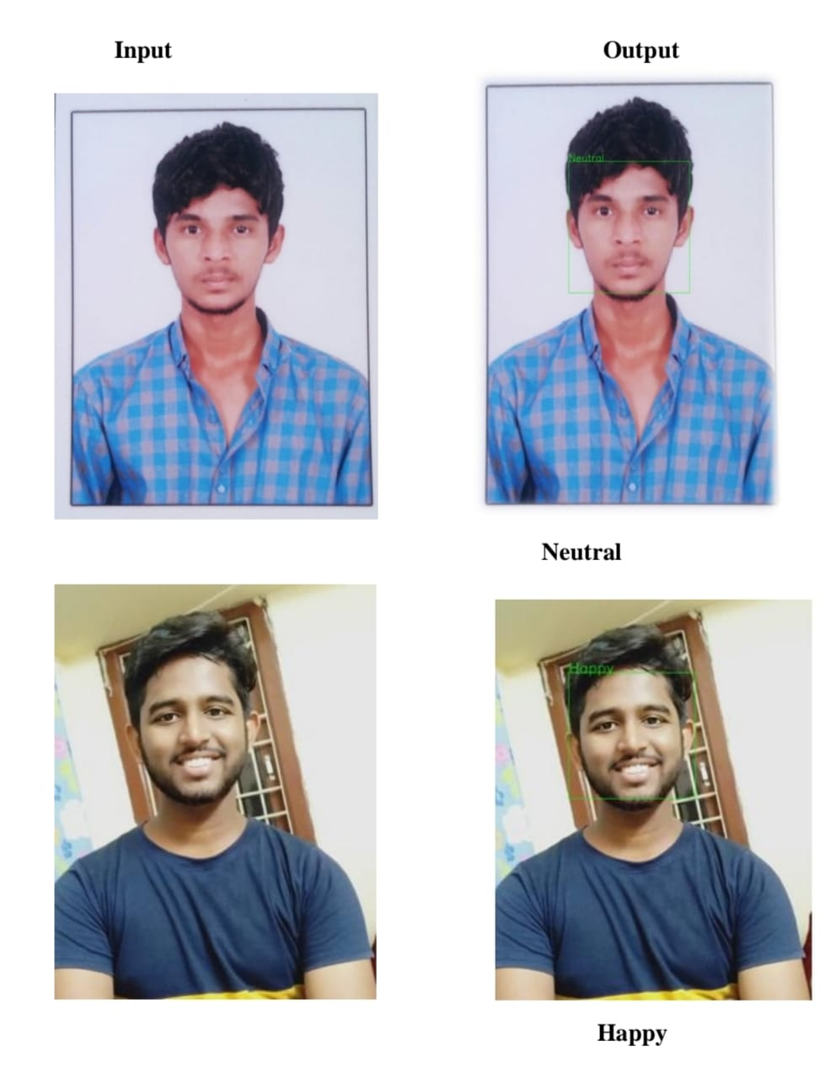
Project Screenshots

Slide 9
T
H
A
N
K
Y
O
U

